Slide 1



R-LADIES GABORONE FIRST MEETUP
06 November 2021

Slide 2
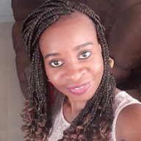
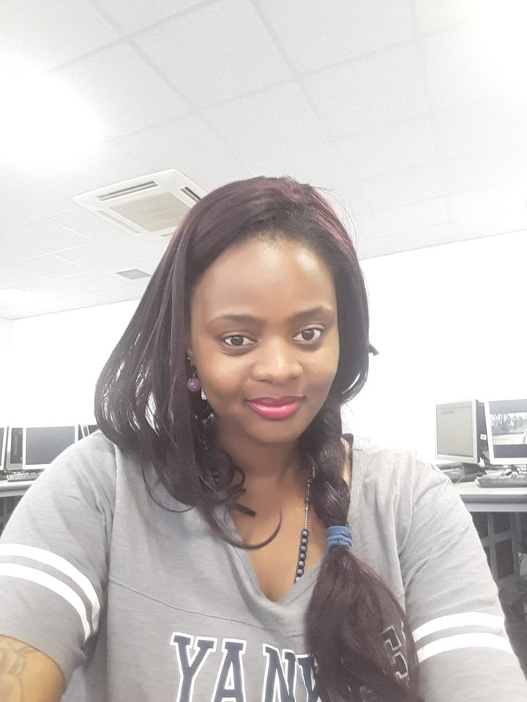
FOUNDERS & organisers
Msc Computer Science, graduating-2021
Founder & Co-organiser of R-Ladies Gaborone, 2021
Interests: Entrepreneur, Data Science
Twitter: @ontizy
Msc Information Systems, graduated-2019
Founder & Co-organiser of R-Ladies Gaborone, 2021
Teaching Assistant at the University of Botswana, 2016-2020
Junior Business Analyst, Gauteng Dept. of
Education, 2012-2014
Interests: Business Intelligence, Data Analysis, Machine Learning, Data Science
Twitter: @simisani10

Slide 3
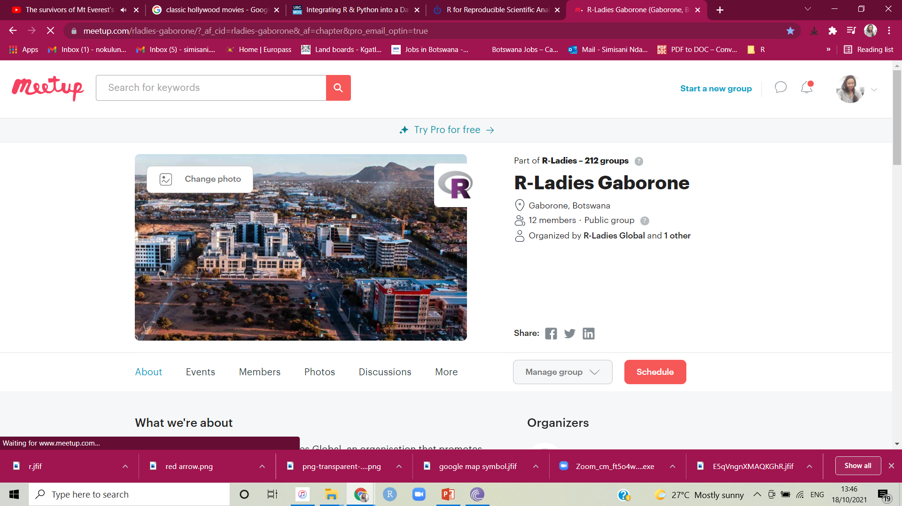
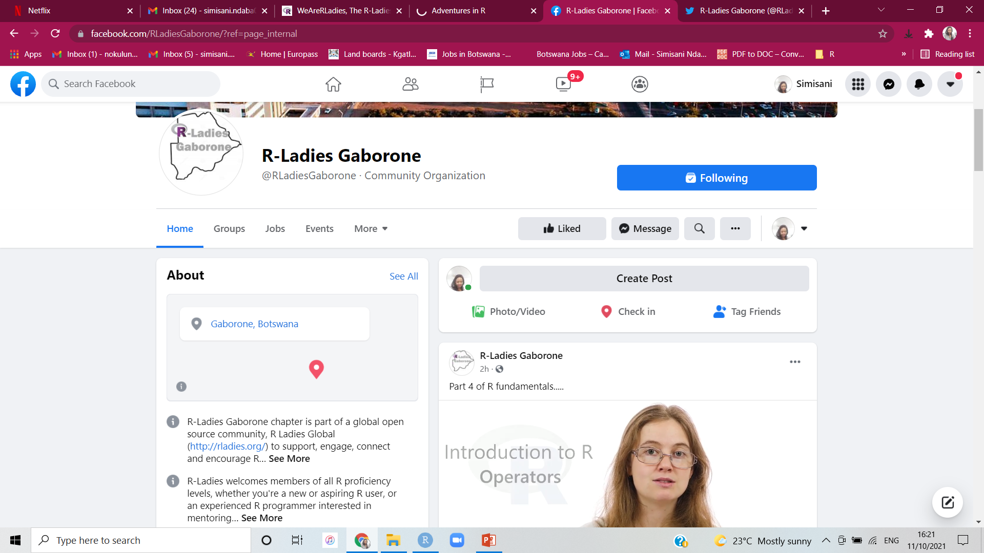
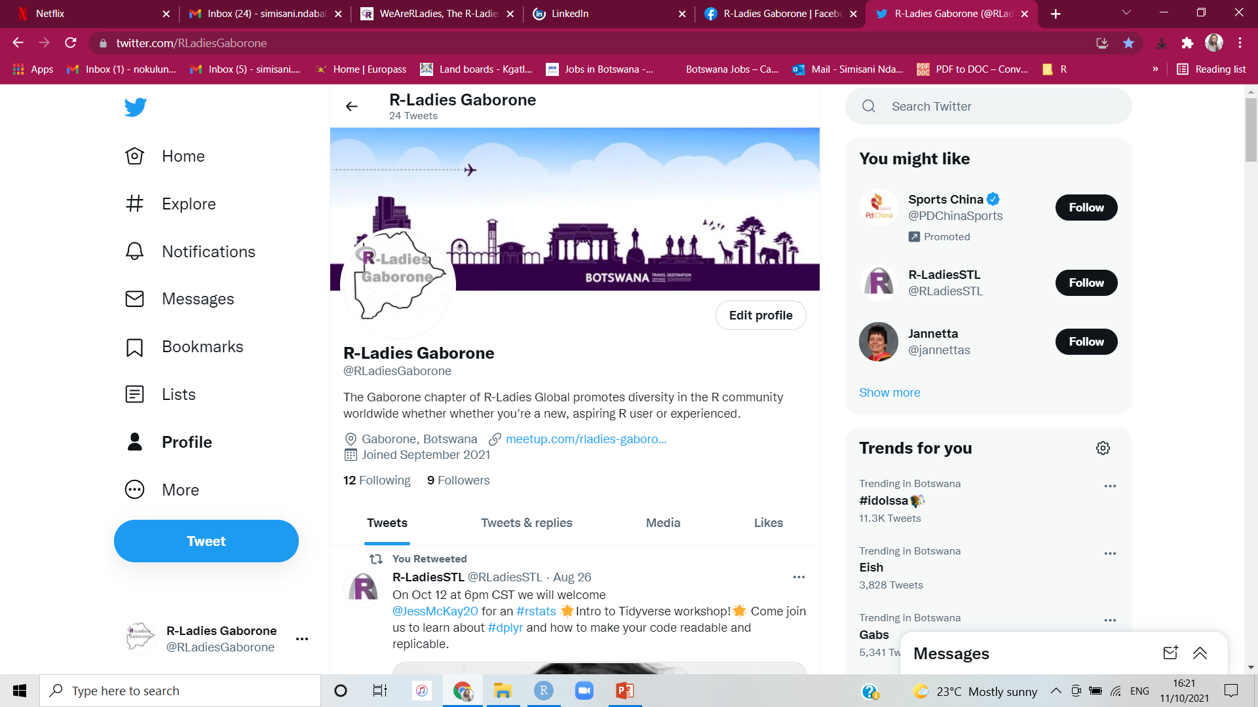
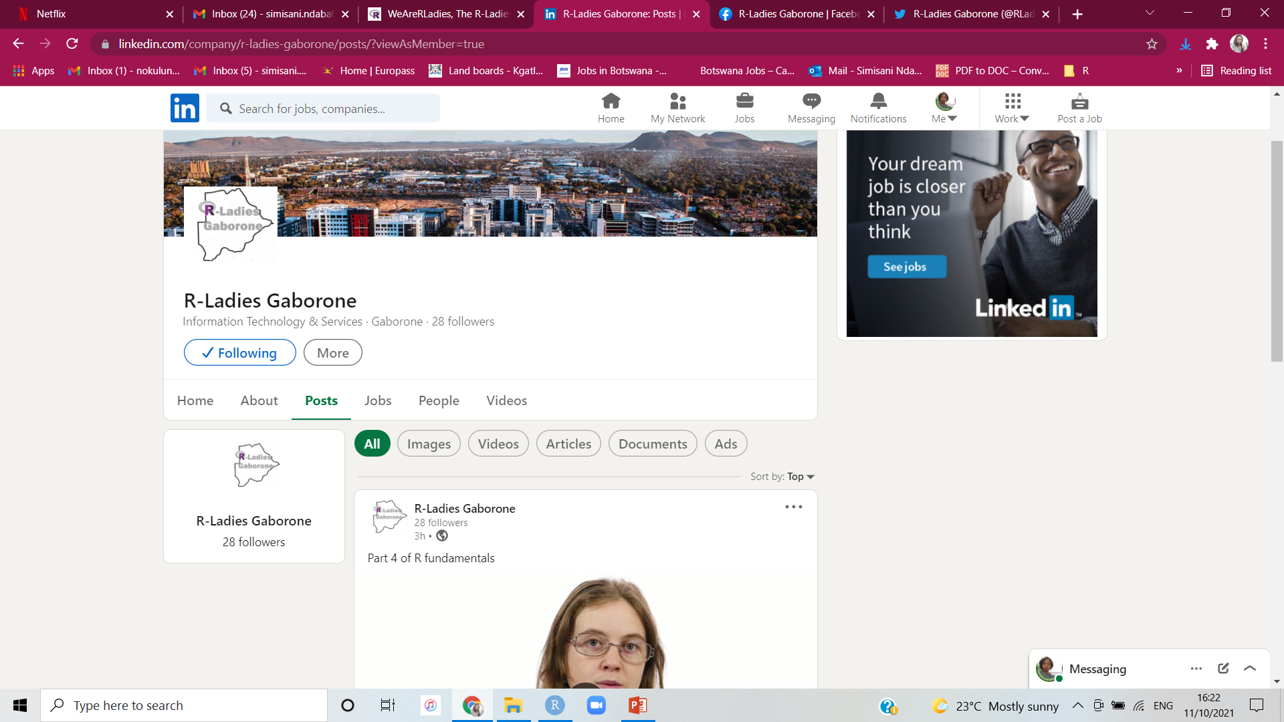
Who are R-LADIES GABORONE

Slide 4
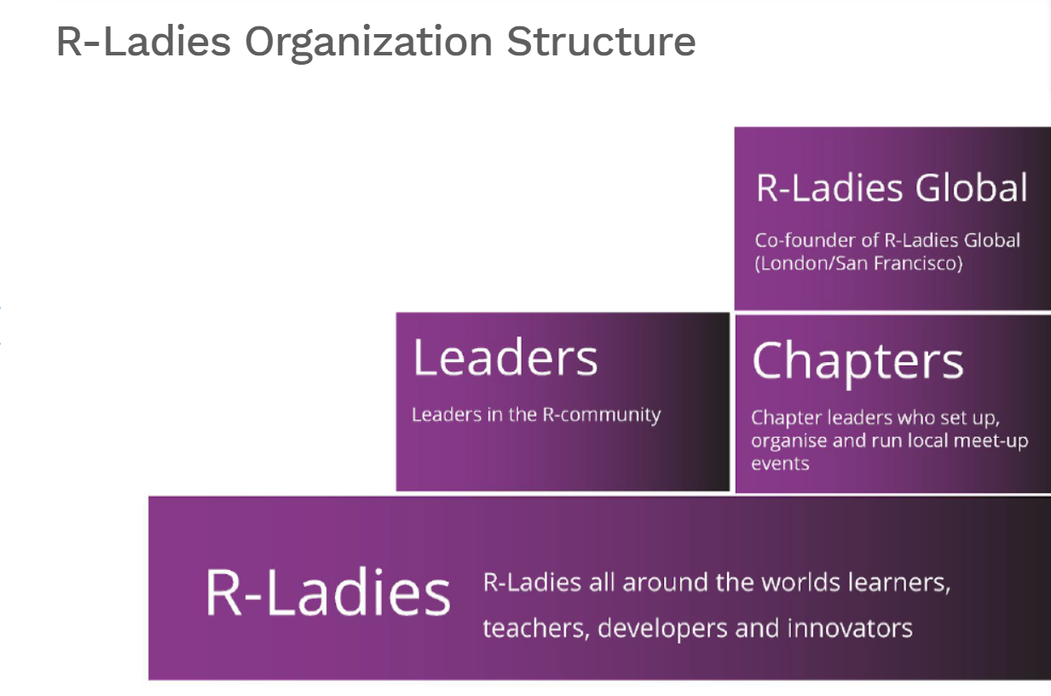

Who are r-ladies gaborone
We Are Here

Slide 5

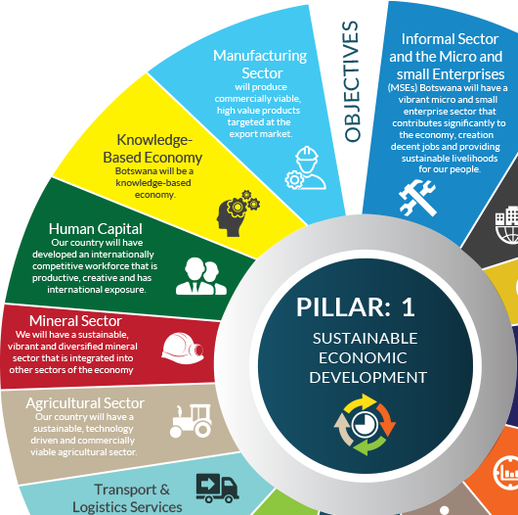
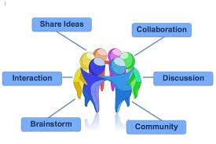

Vision. Mission. aim

Slide 6
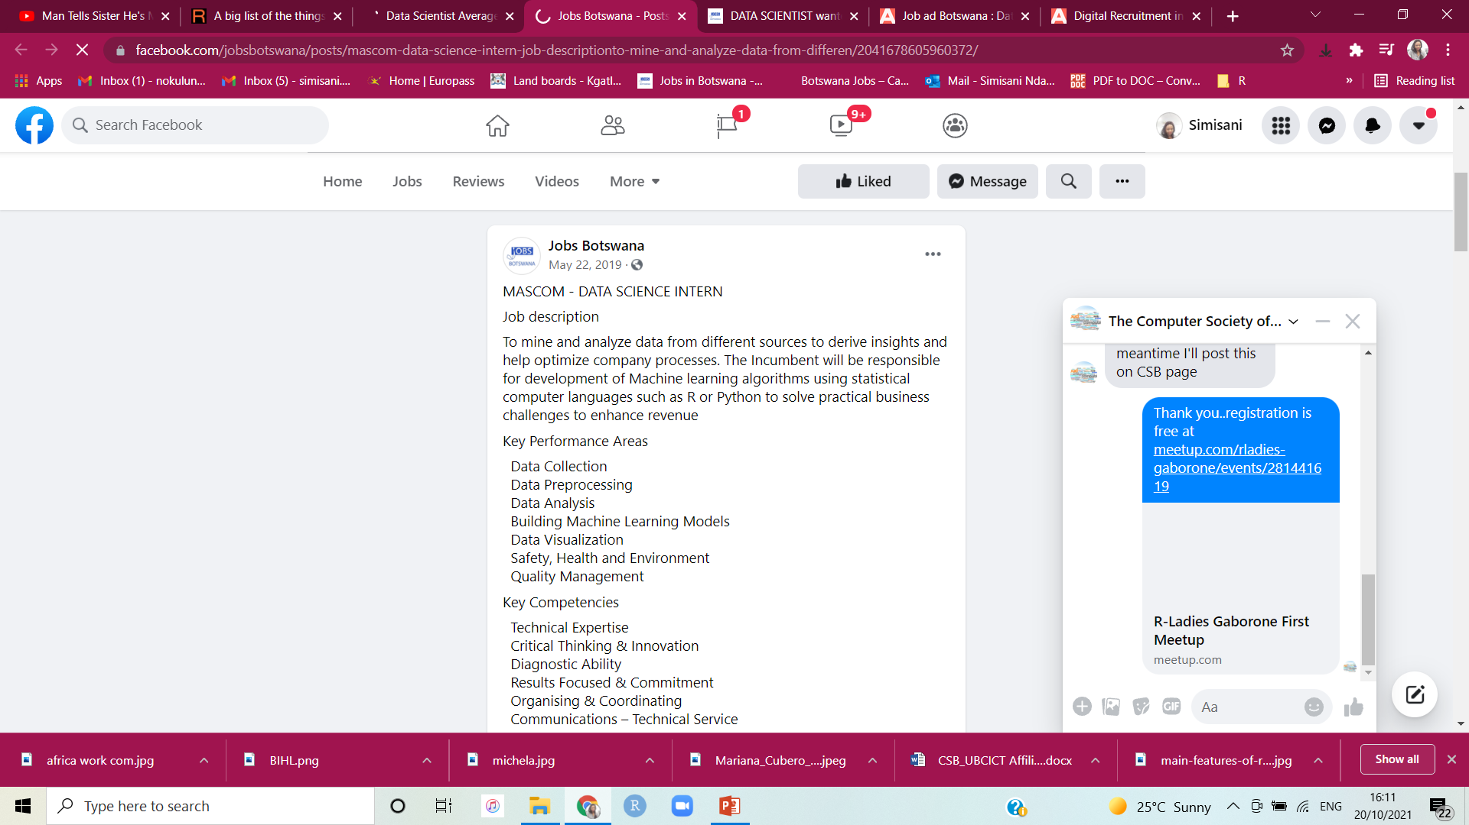
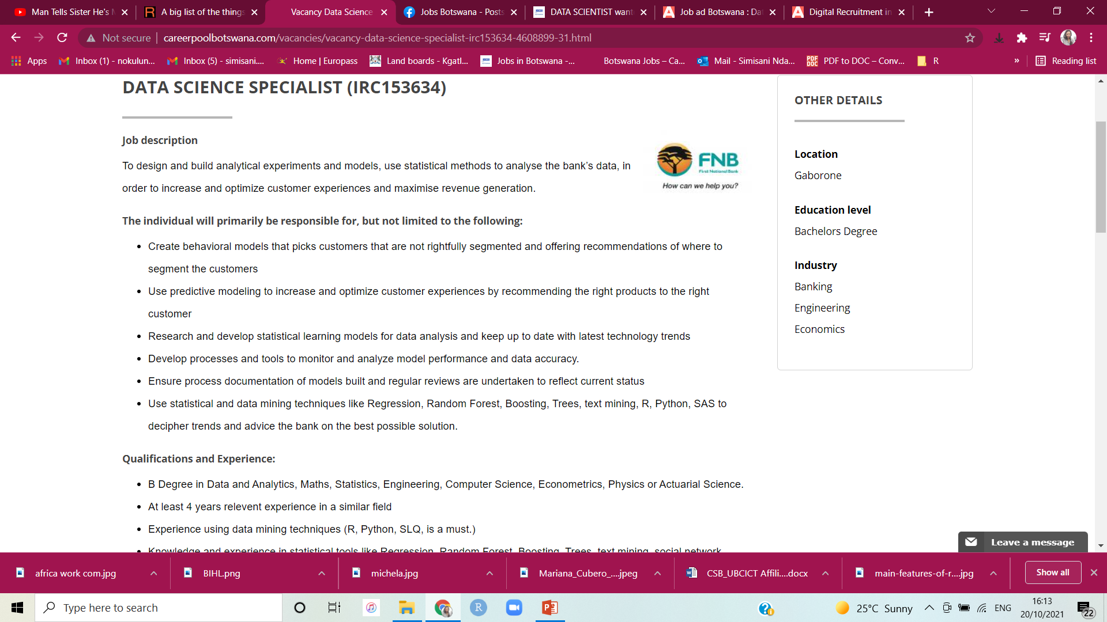

WHERE IS DATA SCIENCE NEEDED

Slide 7






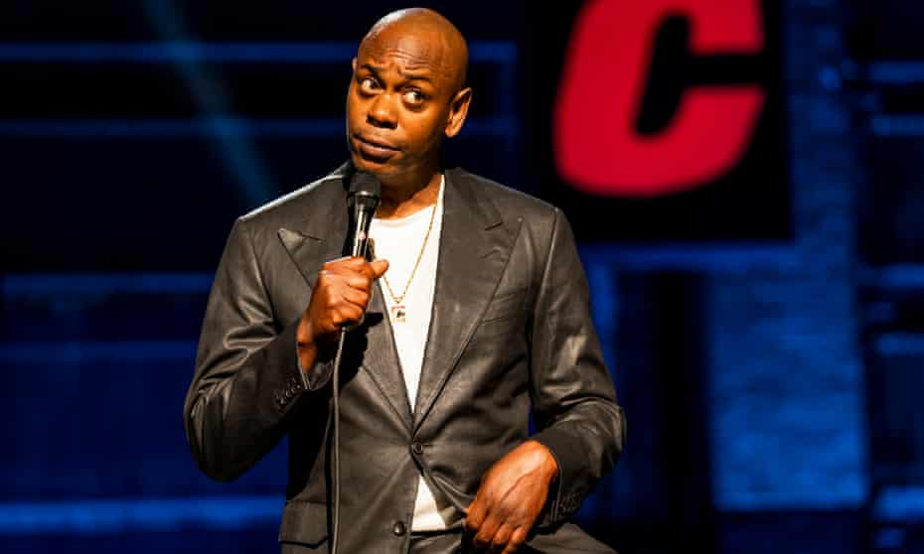
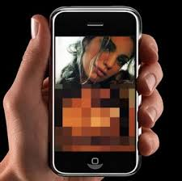
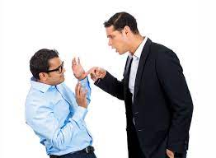

Slide 8
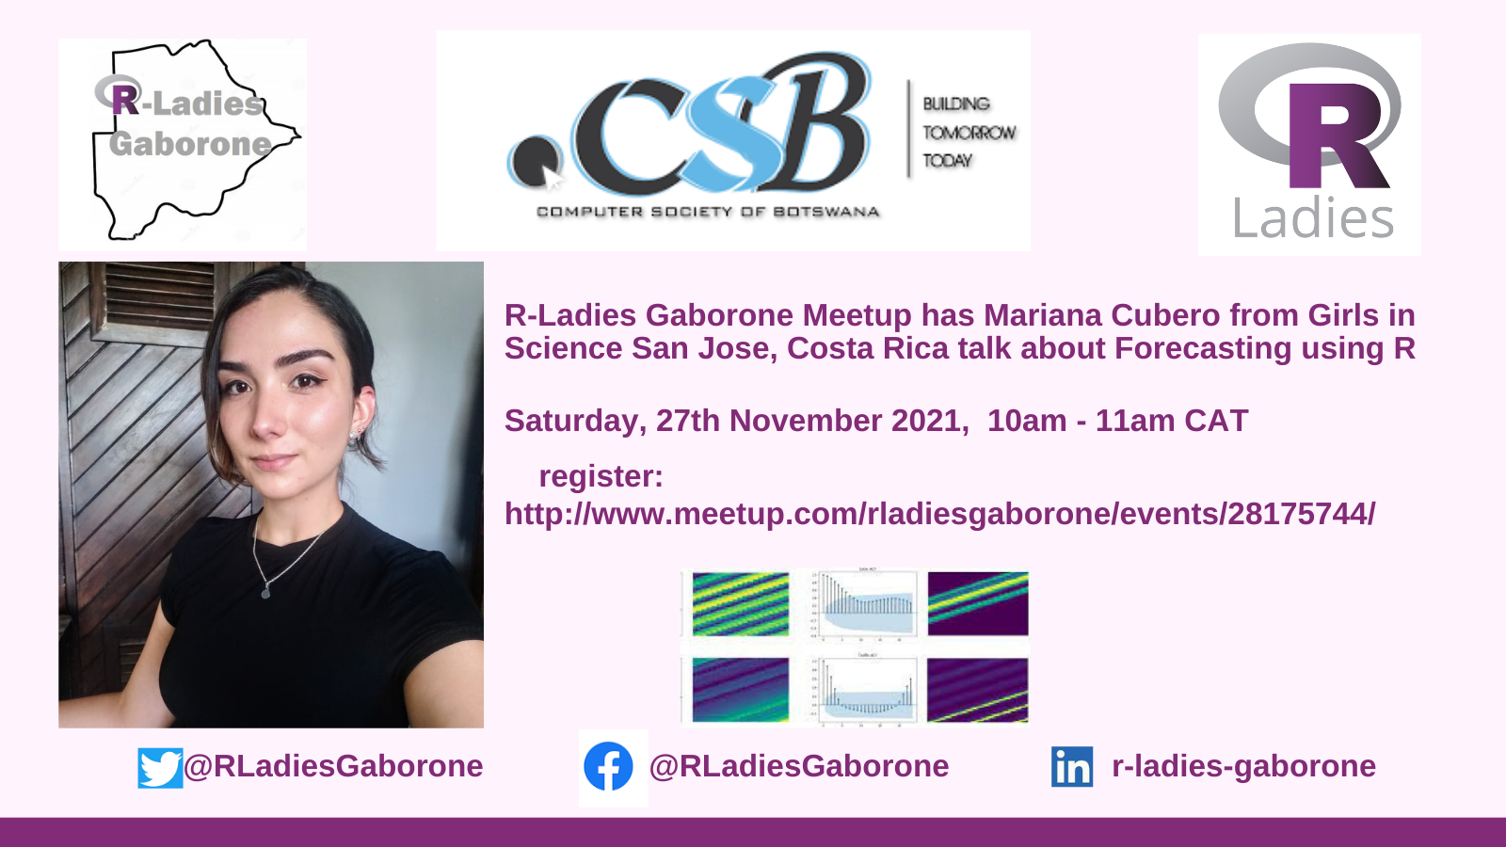
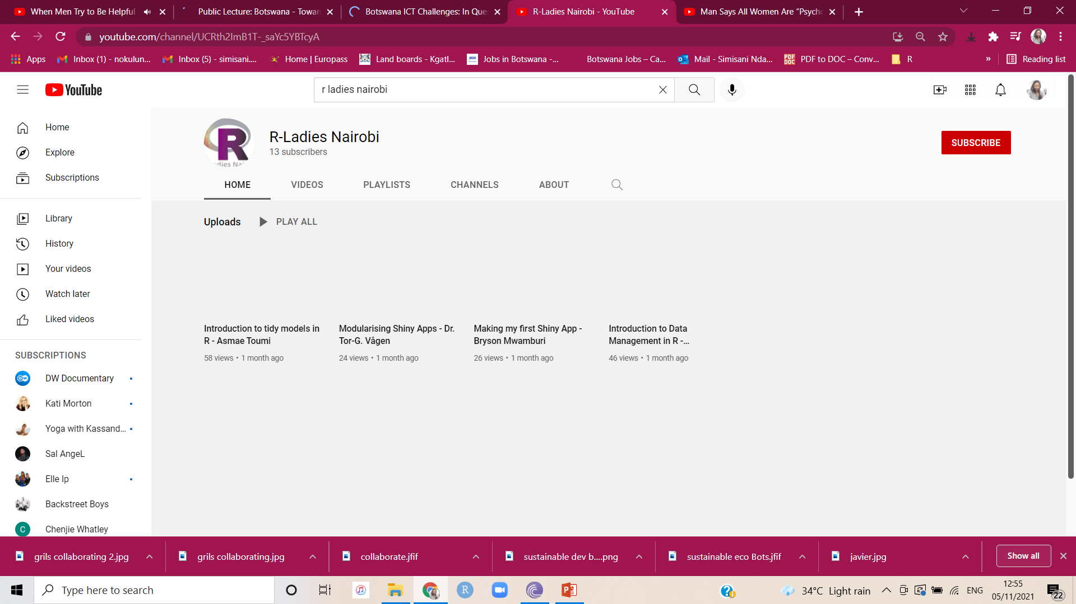
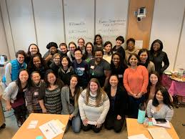
FUTURE EVENTS
Botswana
Physical Meetups

Slide 9
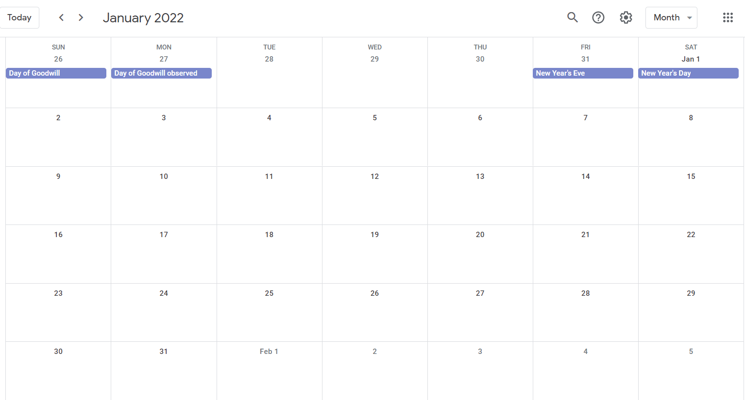
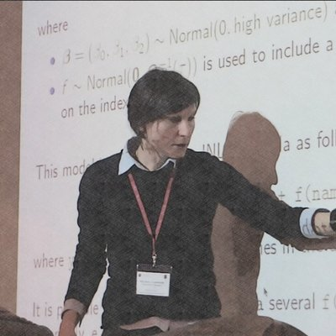
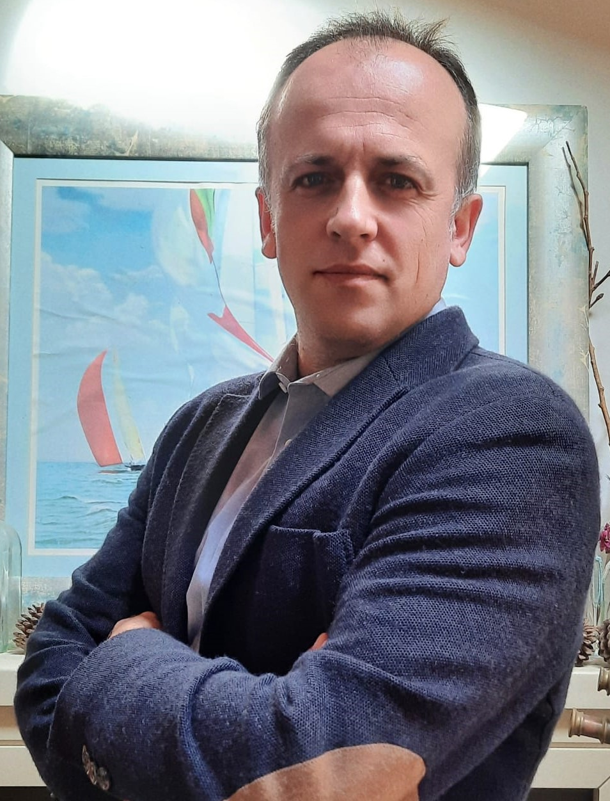
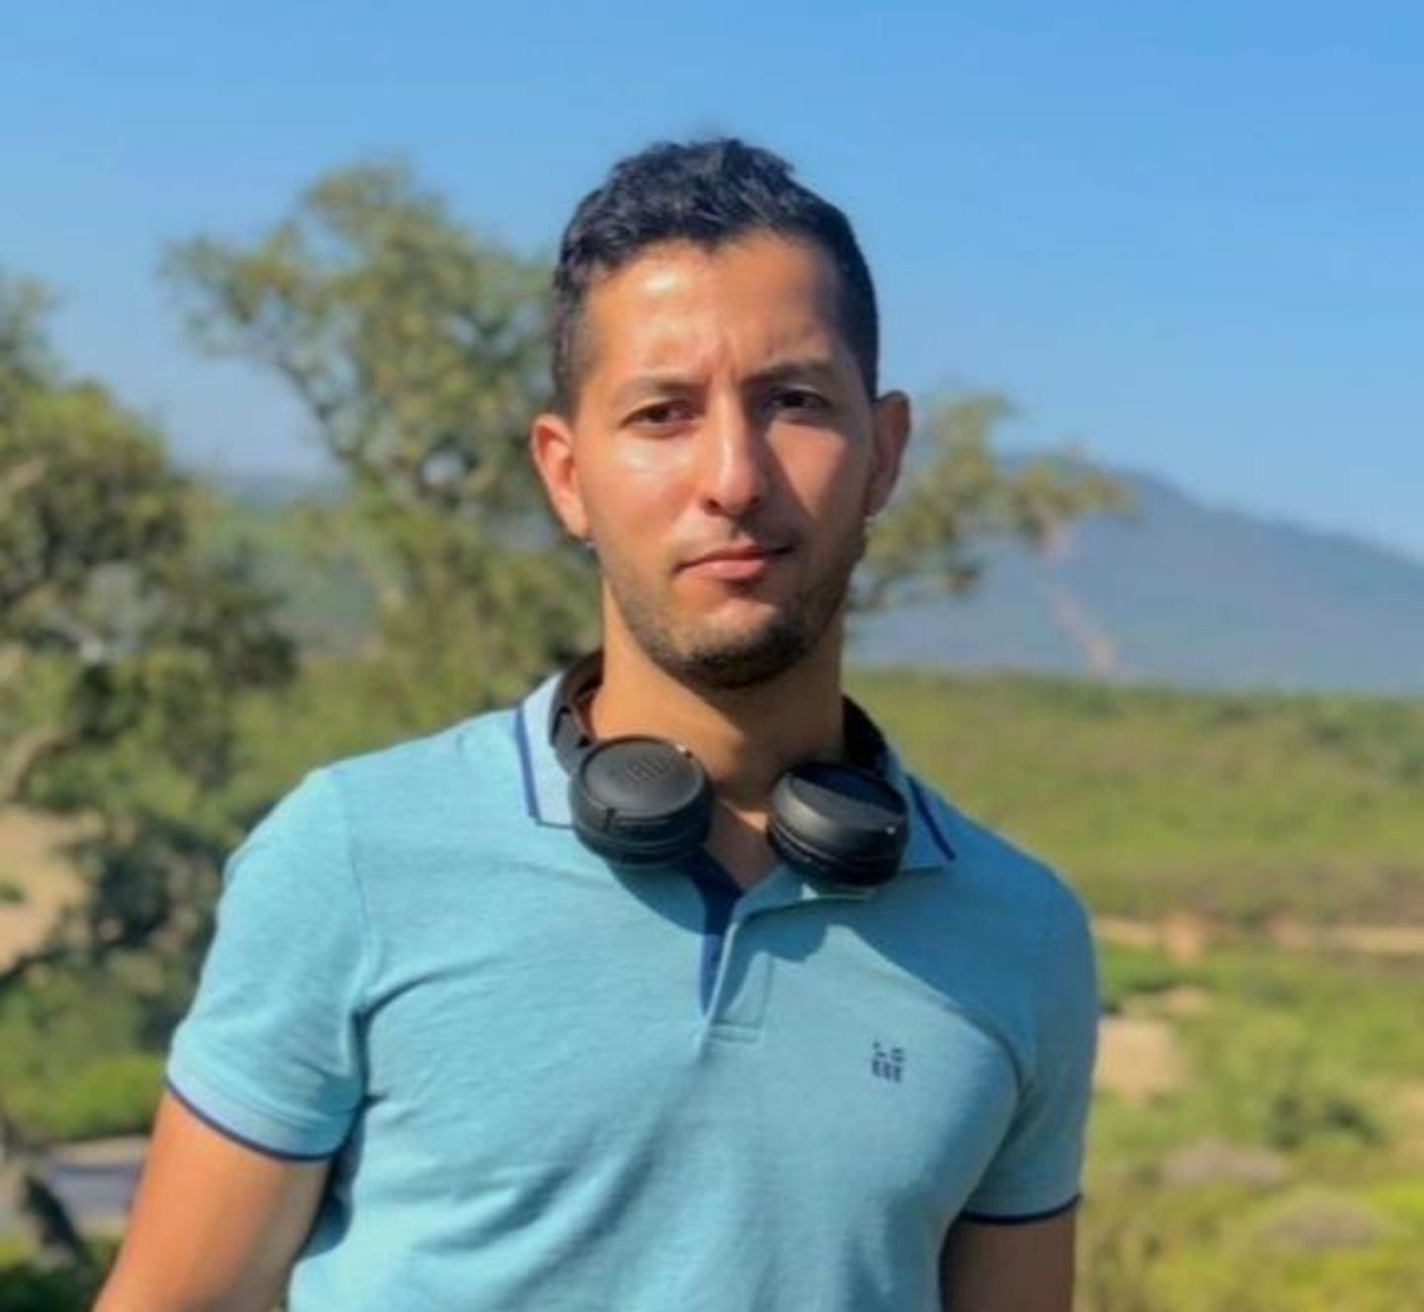
Michela Cameletti, Italy,
R in Academic work
11 December 2021
Simisani Ndaba,
Data Cleaning Using R
22nd January 2022
Mouneem, Tunisia
Medical Science Data Analysis in R
16th February 2022
Dr. Javier Palacios Fenech,
Introduction to R programming...and Survival
12th March 2022

Slide 10




Like-Follow-SHARE
https://www.meetup.com/rladies-gaborone/
https://twitter.com/RLadiesGaborone
https://www.facebook.com/RLadiesGaborone/
https://www.linkedin.com/company/r-ladies-gaborone/

